Slide 1
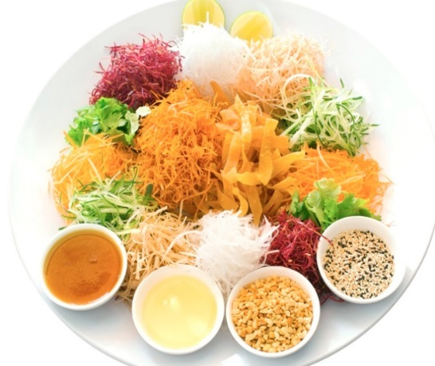
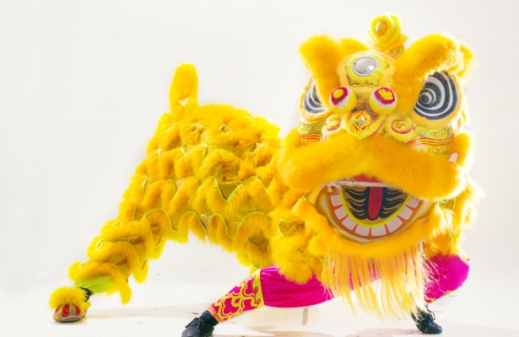
Badminton Veterans Association of South Australia Inc.
Chinese New Year
Year of the Rooster Dinner
Venue: Ming's Palace. 157-159 Gouger St, Adelaide
12 Courses Chinese Food, included a glass of wine, donated by PATRITTI
Date: 3rd February 2017, 7:00pm for 7:30pm start
Members: $25; Non Members: $55
Seats limited. Book early.
RSVP: secretary@bvasa.org by 17th Dec 2016. Pay by 21st Jan 2017
The Rooster is tenth in the Chinese zodiac.
Each year is related to an animal sign according to a 12-year cycle. Years of the Rooster include 1921, 1933, 1945, 1957, 1969, 1981, 1993, 2005, 2017.

